Slide 1
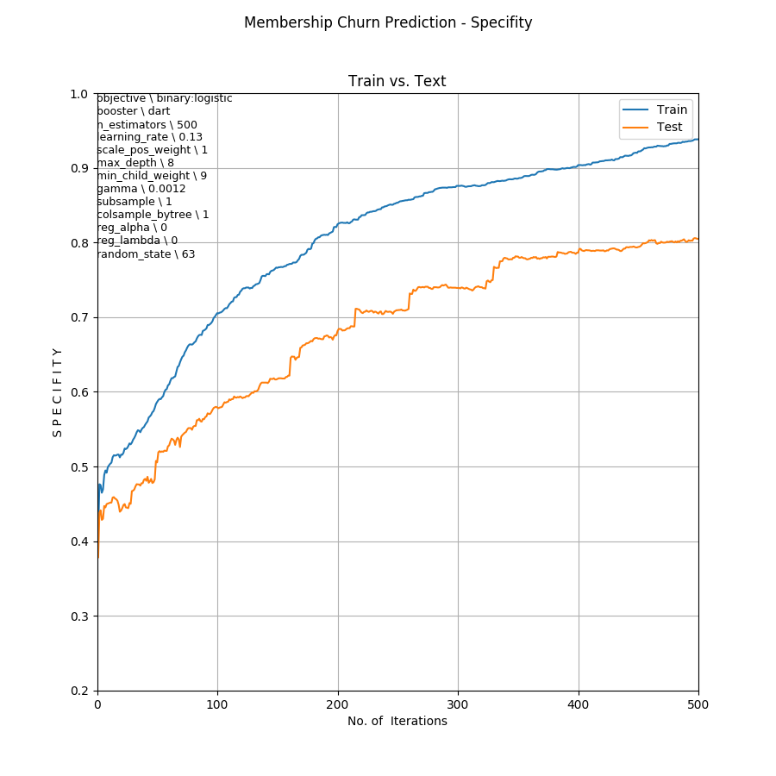
Membership Churn Prediction
Cross Validation Plot
Sensitivity / Recall
Number of Iterations

Slide 2
